Slide 1


Natural Language Processing with Disaster Tweets
-Sai Kumar Reddy Nossam
-Vineeth Billakanti
-Abhinay Reddy Guntipally
-Likitha Guthikonda

Slide 2

CONTENTS
Removing URLs and Hashtags
Removing Punctuation
Removing Stop Words
Non-word Characters

Slide 3
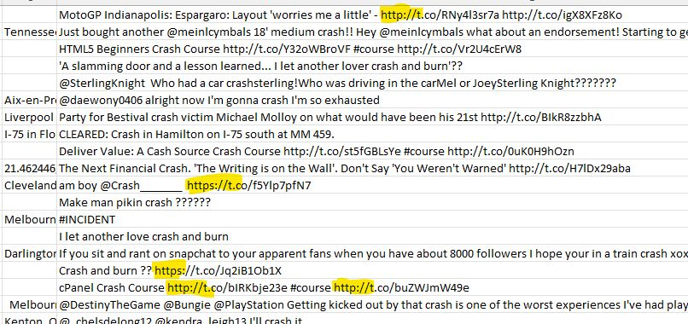
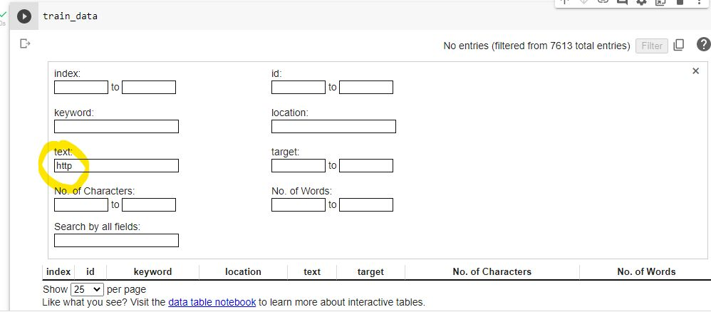
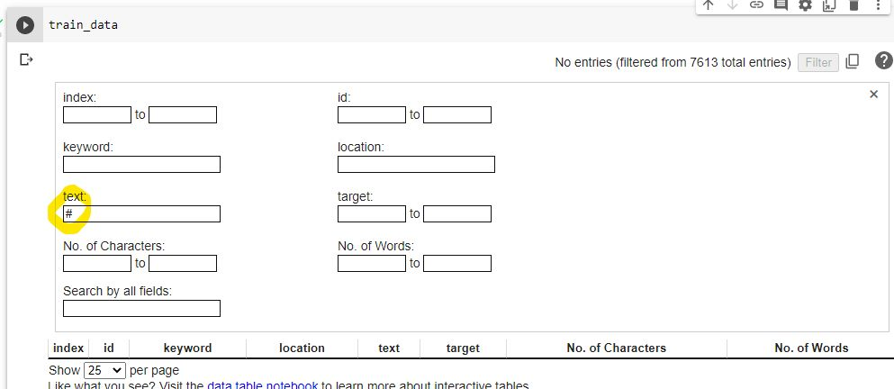
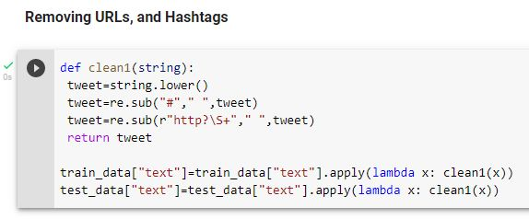
1. Removing URLs and Hashtags
#1
#3
#2
#4

Slide 4
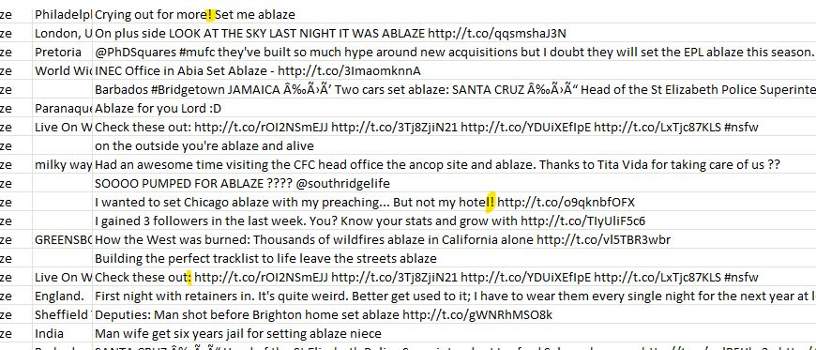
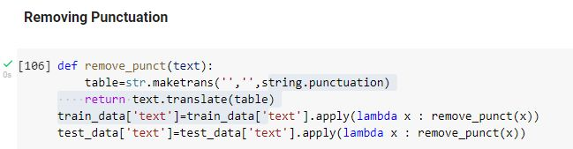
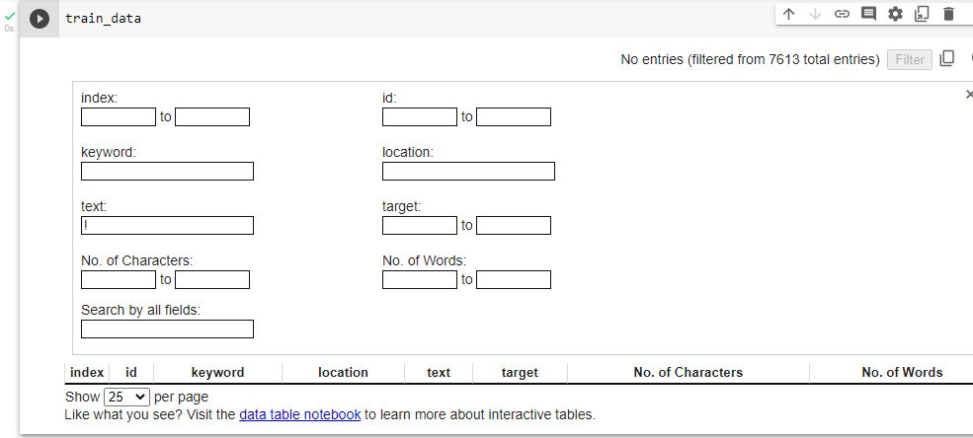
2. Removing Punctuation
#1
#2
#3

Slide 5
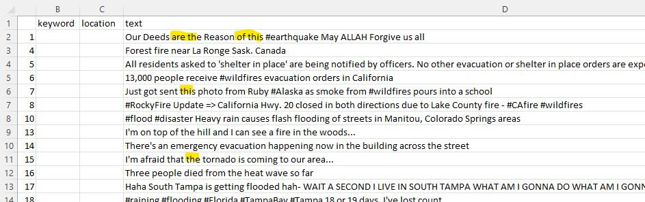
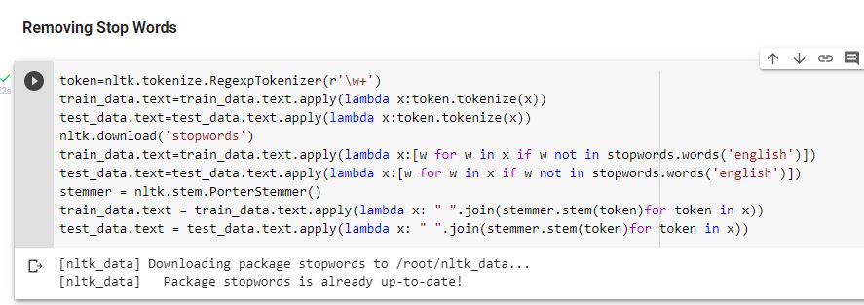
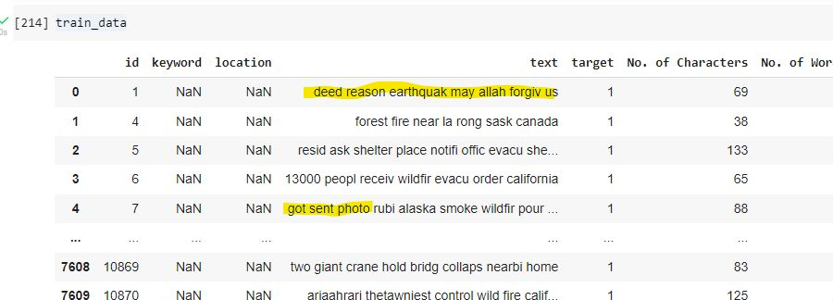
3.Removing Stop Words
#1
#2
#3

Slide 6
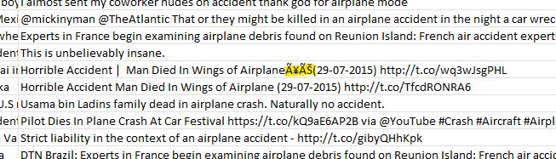
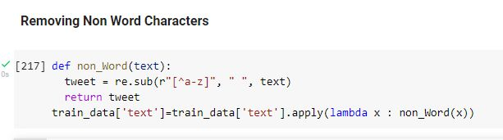
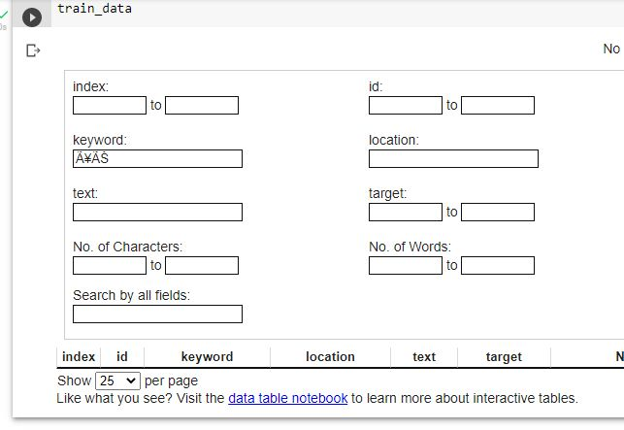
4. Non-word Characters
#1
#2
#3

Slide 7
THANK YOU

